Slide 1
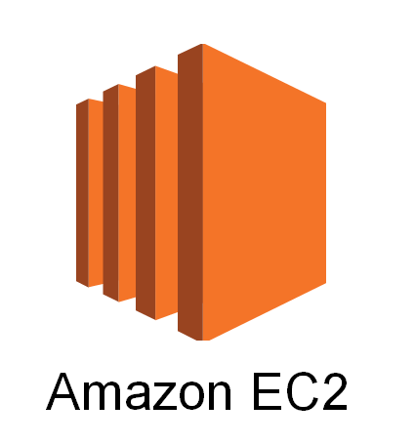

Slide 2
What is EC2?
• EC2 stands for Elastic Compute Cloud
• It's a virtual server in the cloud
• You can run applications and store data
• Pay only for what you use
• Helps you scale up or down easily

Slide 3
Key Features of EC2
• Multiple instance types (like small, medium, large)
• Different OS choices (Linux, Windows)
• Secure with key pair and security groups
• Attach storage (EBS) to instances
• Auto-scaling and load balancing support

Slide 4
Steps to Launch an EC2 Instance
1. Login to AWS Console
2. Go to EC2 Dashboard
3. Click 'Launch Instance'
4. Choose AMI (OS)
5. Select Instance Type
6. Configure Settings
7. Add Storage (EBS)
8. Add Tags (Optional)
9. Configure Security Group
10. Review and Launch
11. Choose/Create Key Pair

Slide 5
EC2 Instance Lifecycle
• Pending: Instance is launching
• Running: Instance is active
• Stopping: Instance is shutting down
• Stopped: Instance is off (not billed)
• Terminated: Instance is deleted

